Slide 1

PROCESS MINING VIRTUAL INTERNSHIP
by
P. LOKSAI
Roll No. 214G1A3248
Department of Computer Science and Engineering (Data Science)
Srinivasa Ramanujan Institute of Technology
(Affiliated to JNTUA & Approved by AICTE) (Accredited by NAAC with ‘A’ Grade & Accredited by NBA (EEE, ECE & CSE)
Rotarypuram Village, B K Samudram Mandal, Ananthapuramu – 515701.
2023 - 2024

Slide 2

Contents
Course Objective
Introduction
Technology
Applications
Modules
Real Time applications
Learning outcomes
GitHub Link
Queries

Slide 3
Course Objective
Participants will gain a comprehensive understanding of process mining's variance applications across industries.
Understanding the fundamental concepts and principles of process mining.
Learning how to apply process mining techniques to real-world datasets.
Gaining knowledge in using process mining tools and software.
Acquiring knowledge of advanced process mining techniques, such as predictive analytics and decision mining.

Slide 4
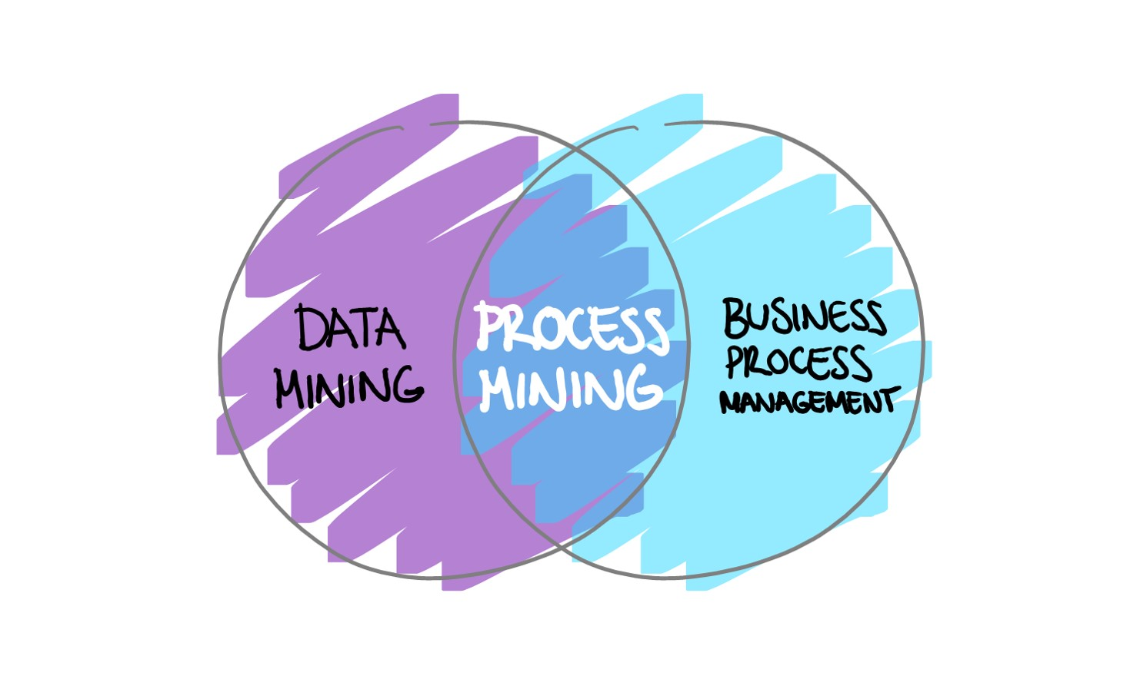
Introduction
What is process mining?
Process mining is a technique that analyzes event data to discover, visualize, and improve processes.
It helps uncover hidden patterns, bottlenecks, and inefficiencies in processes.
It uses data mining, machine learning,
and business process management techniques
to analyze and improve business processes.

Slide 5
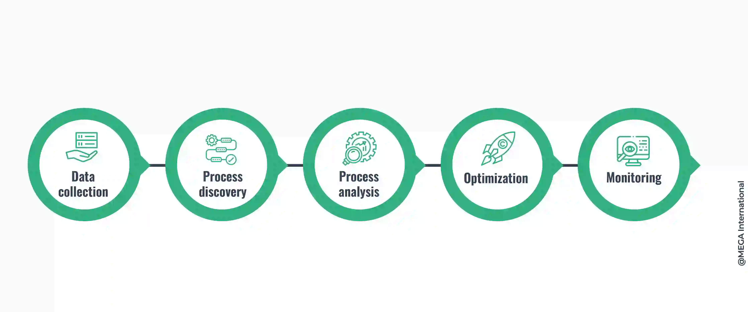
Contd....
How process mining works?
1. Data Collection:
It involves gathering event logs or data from various sources.
2. Process Discovery:
It extract process models from event logs, allowing for the visualization and understanding of the actual process flow.

Slide 6
Contd....
3. Process Analysis:
It gain insights into process performance, bottlenecks, and inefficiencies. It helps identify patterns, variations, and opportunities for process improvement.
4.Optimization:
It improves the efficiency and effectiveness of processes by analyzing event data. It helps to achieve better outcomes.
5.Monitering:
It involves in tracking and analyzing event data to keep an eye on the performance of processes in real-time. It helps to identify bottlenecks and deviations.

Slide 7
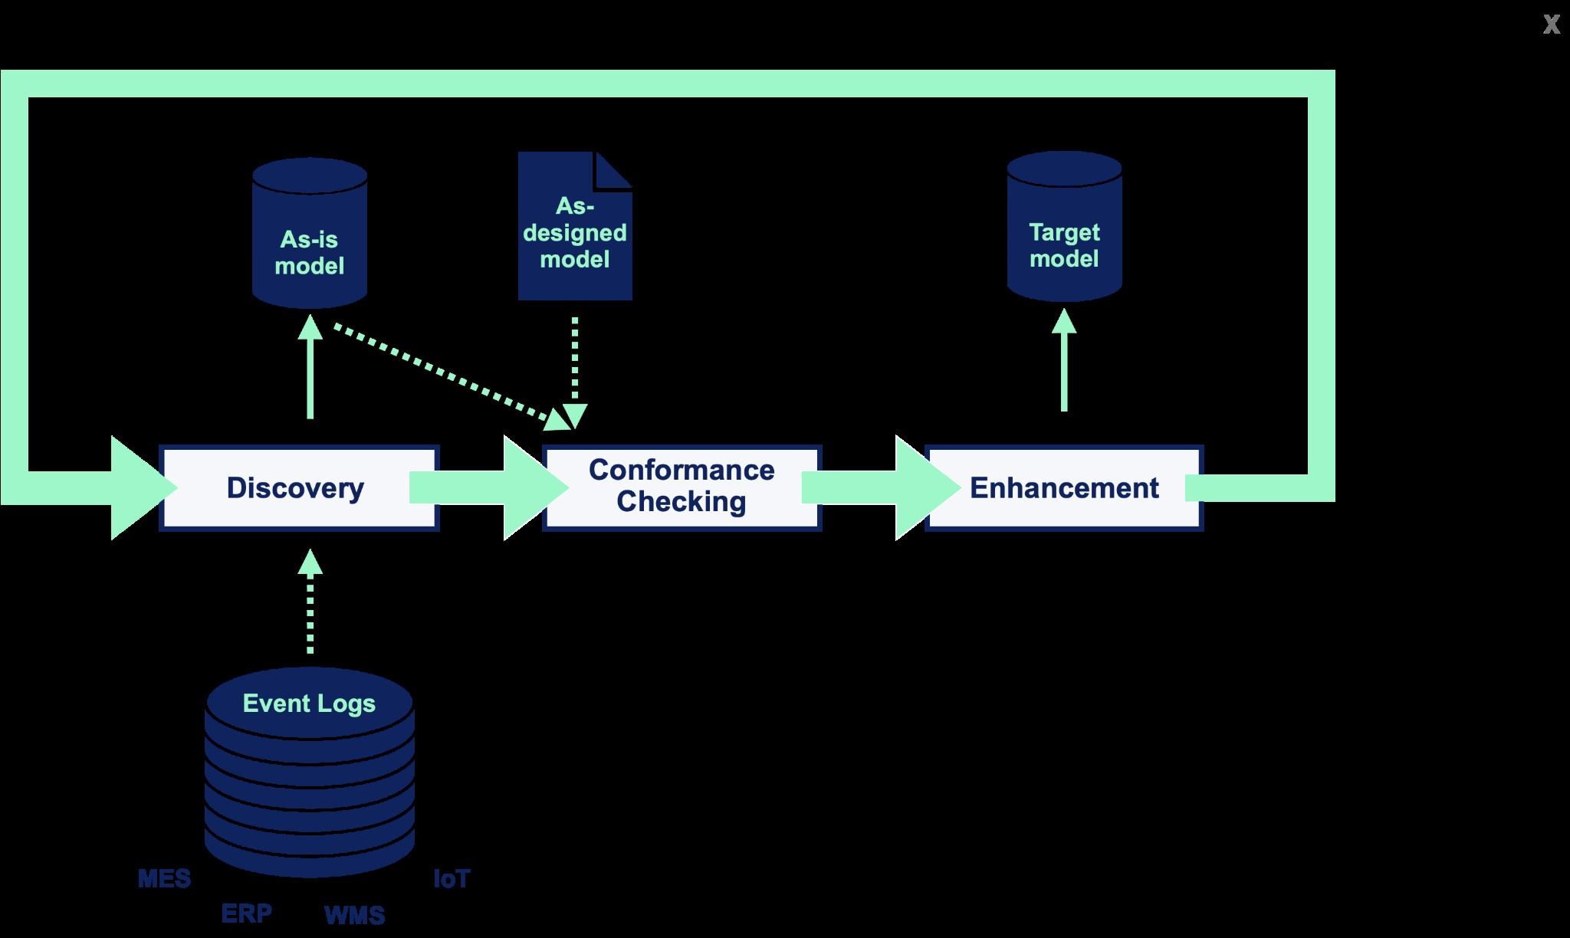
Technology
Process mining technologies encompass a range of tools and techniques that enable the analysis and optimization of business processes.

Slide 8
Contd...
Some popular process mining technologies include:
Process Discovery: These technologies automatically extract process models from event logs, allowing for the visualization and understanding of the actual process flow.
Conformance Checking: These technologies compare the discovered process model with the expected or desired process model, identifying deviations and highlighting areas for improvement.
Performance Analysis: These technologies analyze process execution data to identify bottlenecks, inefficiencies, and opportunities for optimization. They provide insights into process cycle times, resource utilization, and other performance metrics.

Slide 9
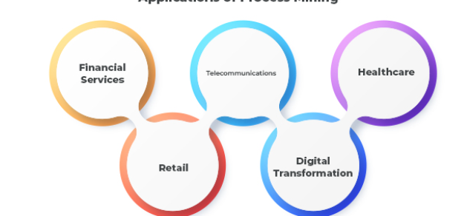
Applications
Process Discovery for Automation:
Automation helps you work faster and save money. But these process mining special tools work even better if you study how you work first, and there are companies that say their tools can help you finish your work even faster than normal by 50%.

Slide 10
Contd....
Financial Services:
In the world of finance and business,where aton of transactions are happening online, process mining is likehaving a super detective that makes sure everything is going smoothly and follows the rules. This is really helpful because rulesand regulations are getting more strict, and companies need to show that they're playing by the rules.
Performance Monitoring:
Process mining helps the company see how well they're doing. It looks at things like how fast tasks are getting done, if there are any problems slowing things down, or if people are doing things the right way.

Slide 11
Modules
Data Extraction and Collection:
• In this initial phase, relevant data is extracted from various sources, such as ERP systems, databases, and application logs.
The data collected usually includes timestamps, activity names, case IDs, and other relevant attributes that capture the process execution.
Predictive Analysis:
• Some advanced process mining tools incorporate machine learning techniques to predict future process behaviors based on historical data.
• Predictive analytics can be used to forecast potential bottlenecks or delays and make proactive adjustments.

Slide 12
Contd....
Preprocessing and Data Transformation:
Raw data is often messy and complex. In this module, the data is cleaned, organized, and transformed into a suitable format for analysis. Irrelevant or incomplete data is removed, and the remaining data is structured to prepare it for further processing.
Visualization and Reporting:
Effective visualization tools are used to represent process models, performance metrics, and conformance analysis results.Clear visualizations help stakeholders understand complex process dynamics and make informed decisions.

Slide 13
Real-Time Applications
Risk Management in Banking:
Financial institutions can use process mining to monitor real-time data related to financial transactions and identify potential risks or regulatory non-compliance.
Telecommunications Network Monitoring:
Telecom companies can use process mining to monitor their network in real time, ensuring optimal performance, identifying potential outages, and maintaining quality of service.

Slide 14
Contd....
Healthcare Process Improvement:
In healthcare, process mining can be applied to analyze patient treatment pathways, identify variations, and optimize resource allocation in real- time. This can lead to improved patient care and reduced wait times.
Financial Transaction Monitoring:
Process mining can be used in the financial sector to monitor and detect fraudulent activities in real-time. By analyzing transaction logs, it can identify patterns of suspicious behavior and trigger alerts for further investigation.

Slide 15
Learning Outcomes
Process mining is and its importance in analyzing and improving processes.
Explore various real-world applications of process mining across industries and sectors.
Familiarize yourself with basic process mining software and their functionalities.
process mining to discover and visualize actual processes from event logs.

Slide 16
Git Hub Dashboard

Slide 17
Any Queries?

Slide 18
Thank You!!!

